Slide 1


SUPERPETS
Welcome to the exciting world of pet adoption! This project aims to create an intuitive and engaging website that connects loving pet owners with adorable animals in need of a new home. Our goal is to make the adoption process simple and enjoyable for both the users and the pets.

Slide 2
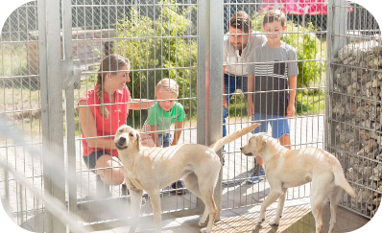
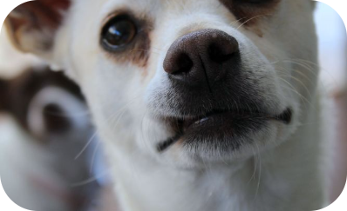
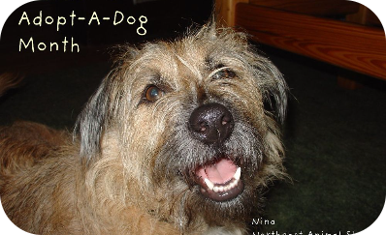
Target Audience and User Personas
Families Looking for Companions
Youthful Professionals Seeking Pets
Seniors Searching for Companionship
We will cater to families searching for a new furry friend to bring joy and companionship into their lives.
We will provide a platform for young professionals who are eager to welcome a pet into their urban lifestyle.
We will connect seniors with a new companion to bring love and warmth into their homes.

Slide 3

Features of the Website
User-Friendly Navigation
Virtual Adoption Events
The website will offer intuitive and easy-to-navigate features, ensuring a seamless experience for all users.
Engage users with virtual adoption events and activities to encourage interaction between potential pet owners and adoptable pets.
Personalized Matchmaking
Advanced algorithms will match pets with potential owners based on lifestyle, preferences, and compatibility.

Slide 4
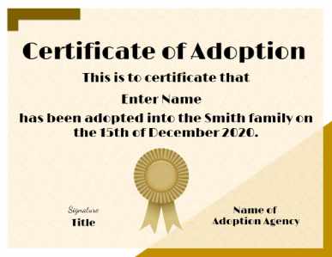
Design and User Experience
Modern and Engaging Interface
Intuitive User Journey
Interactive Pet Profiles
Streamlined pathways and clear calls to action will guide users through the adoption process with ease and simplicity.
Detailed pet profiles with images, videos, and personality traits to help users connect with potential pets.
The website will feature a contemporary and visually appealing design to captivate users from the first click.

Slide 5
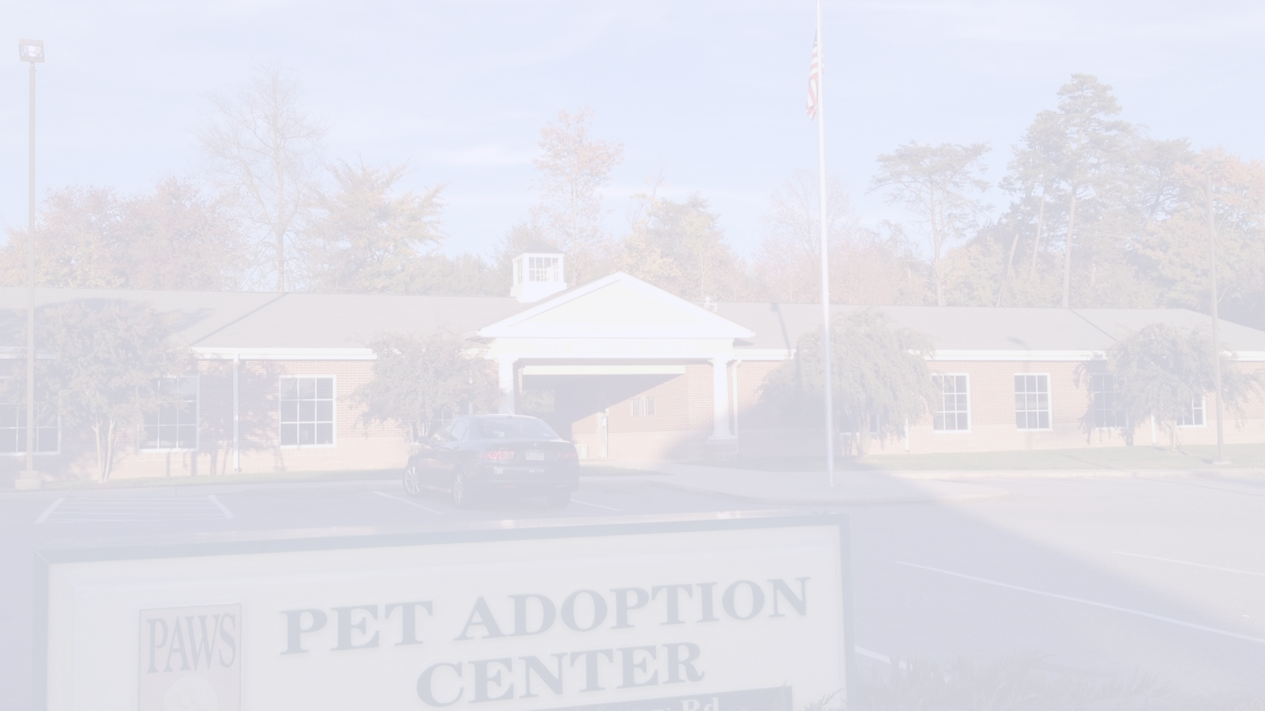
Technical Requirements and Stack
1
Responsive Web Design
2
Secure Payment Integration(To be Updated)
3
Database Management
The website will be optimized for seamless viewing on all devices, including desktops, tablets, and mobile phones.
An efficient database system will ensure smooth operation, data management, and pet profile updates.
Secure payment gateways will be integrated to facilitate adoption fees and donations with trust and confidence.

Slide 6
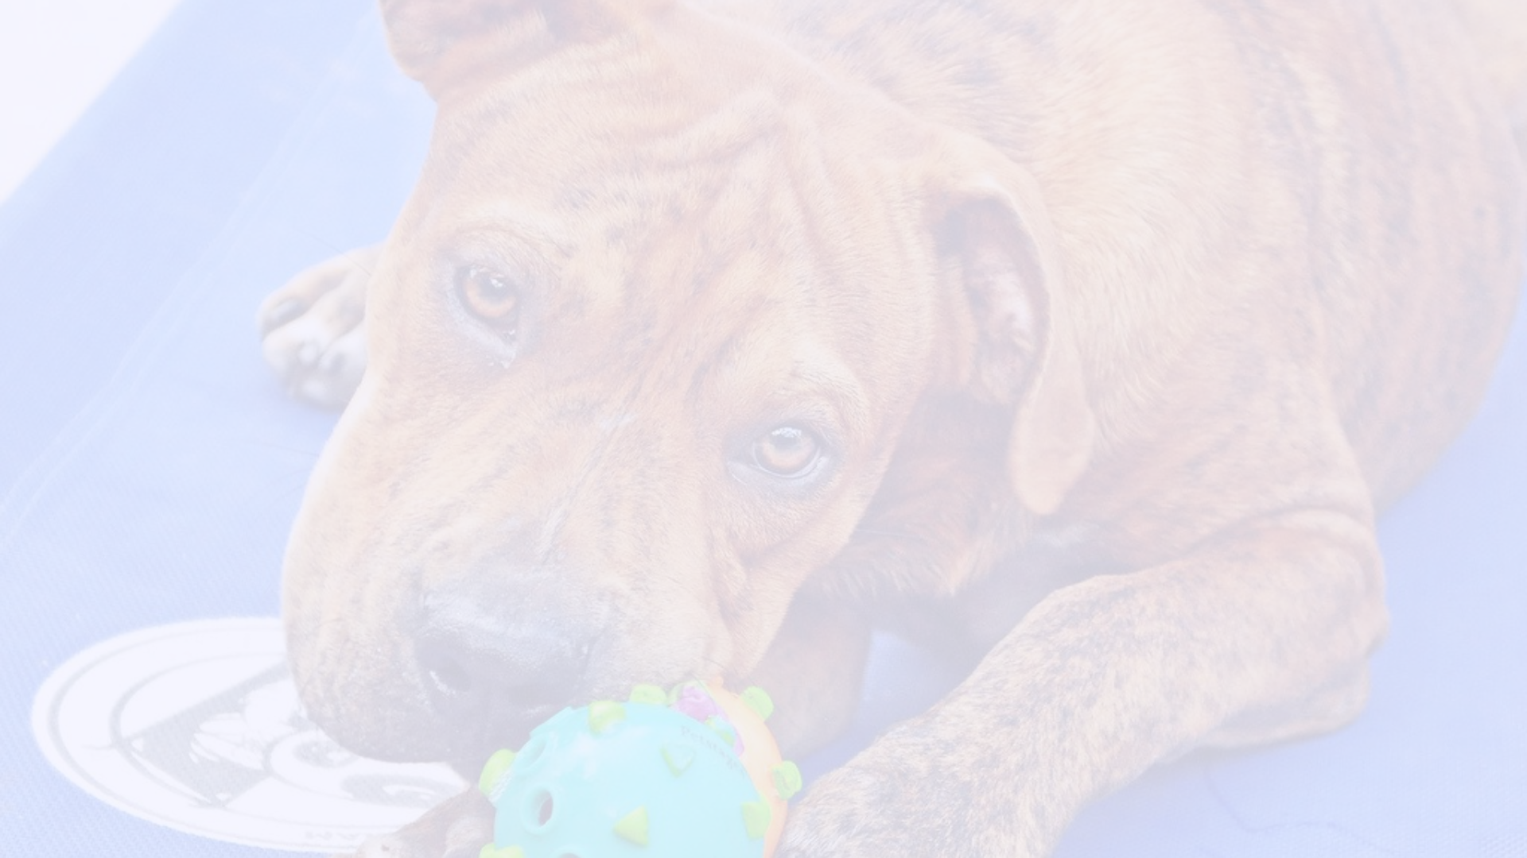
Timeline and Milestones
1
Planning and Research
Thorough planning and extensive research on user behavior, design trends, and technology requirements.
2
Development and Testing
Building the website and rigorous testing to ensure functionality, security, and a seamless user experience.
3
Launch and Adoption Drive
Exciting launch of the website with a focused adoption drive and media outreach.

Slide 7




Marketing and Outreach Strategy
Social Media Engagement
Community Partnerships
Content Creation and Blog
Targeted social media campaigns to reach potential adopters and engage with the pet-loving community.
Establishing partnerships with local businesses and organizations to promote pet adoption awareness and events.
Regularly creating compelling content and blog posts to educate, inspire, and inform the audience about pet adoption.

Slide 8
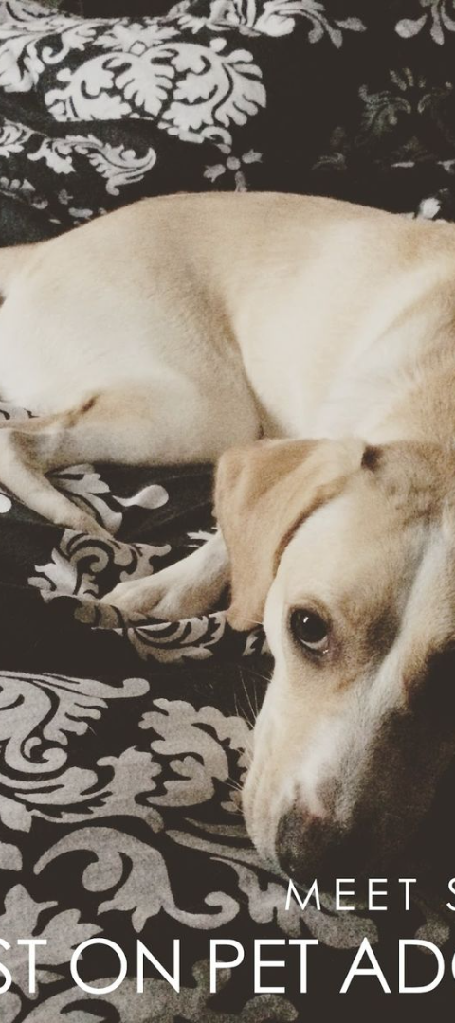
Future Plans and Scalability
Expansion to New Locations
Enhanced User Features
Plans to extend the platform to cover more regions and connect shelters and adopters on a broader scale.
Continuously enhancing the platform with new user-friendly features and interactive tools for a better adoption experience.
Community and Support Growth
Building a strong community around pet adoption with enhanced support systems and resources for adopters and shelters.

Slide 9

Designed and developed by:
Bulbul Singh Chauhan

Slide 10

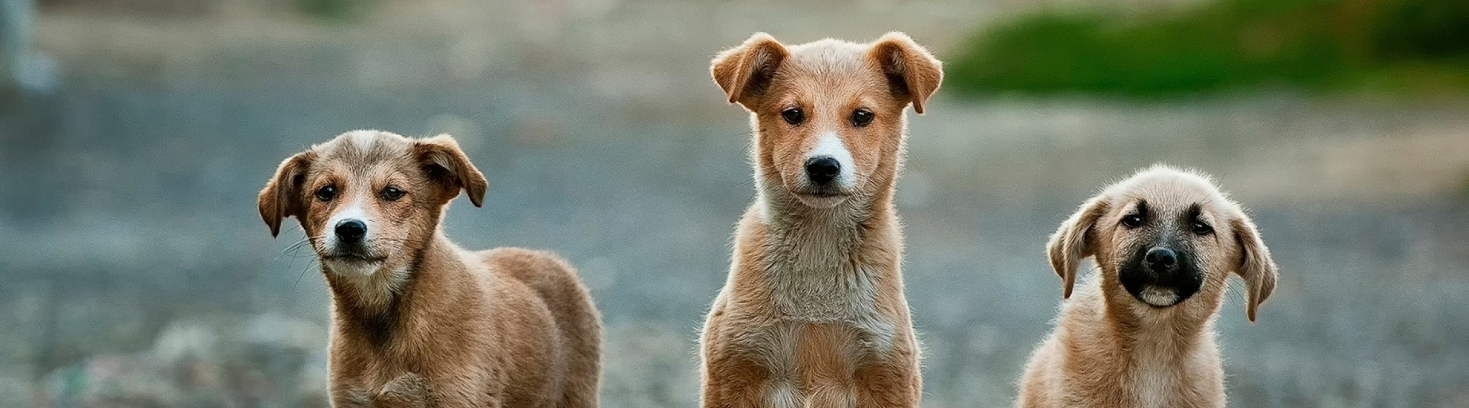
Thank You
We are grateful for the opportunity to embark on this incredible journey of creating a pet adoption website. With your partnership and support, we are confident that we can make a meaningful impact in the lives of pets and pet lovers. Thank you for believing in our vision!

